Slide 1
How to simulate State College in SUMO
Wushuang Bai

Slide 2
The purpose of this presentation is to show how to import a map from OSM, define the demand, and simulate it in SUMO. This presentation uses State College, Pennsylvania, USA as an example, however the procedure can be applied to any other area to be simulated.

Slide 3
The hardware and software running this example is below
Hardware:
OS: Windows 10 (Note that this example used Windows, since the tool, OSMWebWizard, which is used to generate road network and demand from OSM, ran into errors on Ubuntu )
Processor: AMD Ryzen 7 1700X Eight-Core Processor
RAM: 16.0 GM
Software:
SUMO 1.13.0

Slide 4
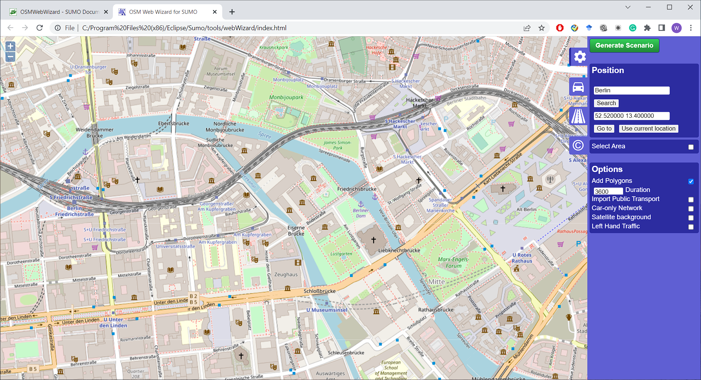
Step 1. Run OSMWebWizard by running command “python3 osmWebWizard.py”.

Slide 5
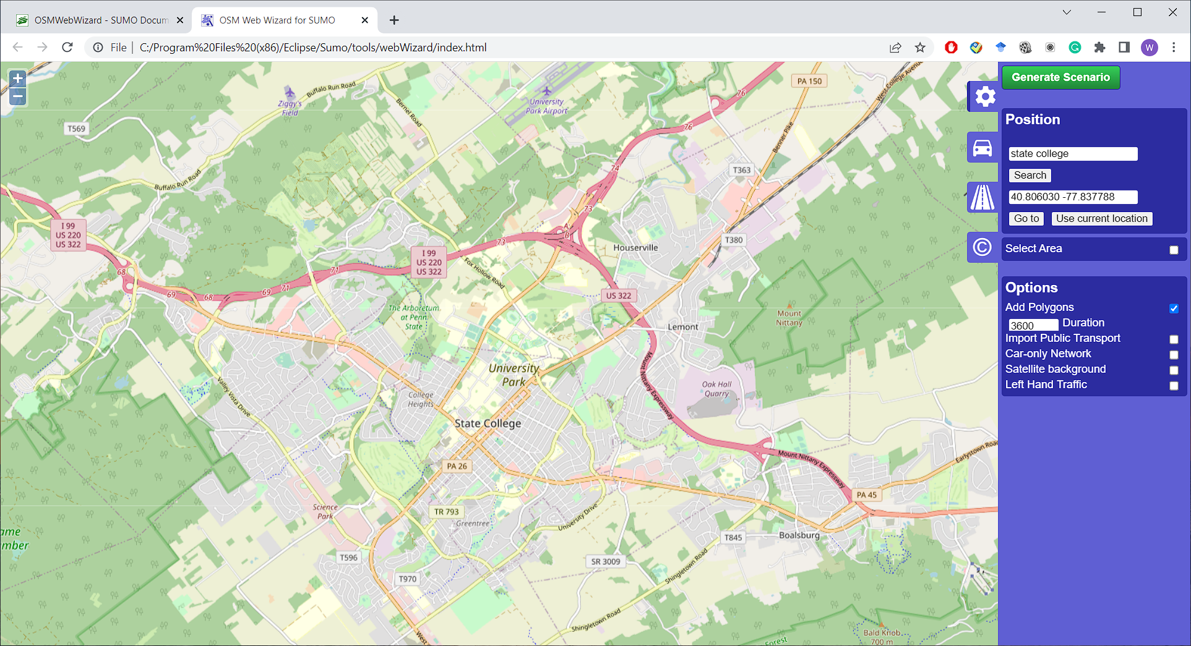
Step 2. Search for State College by inputting “State College” and clicking on “Search”

Slide 6
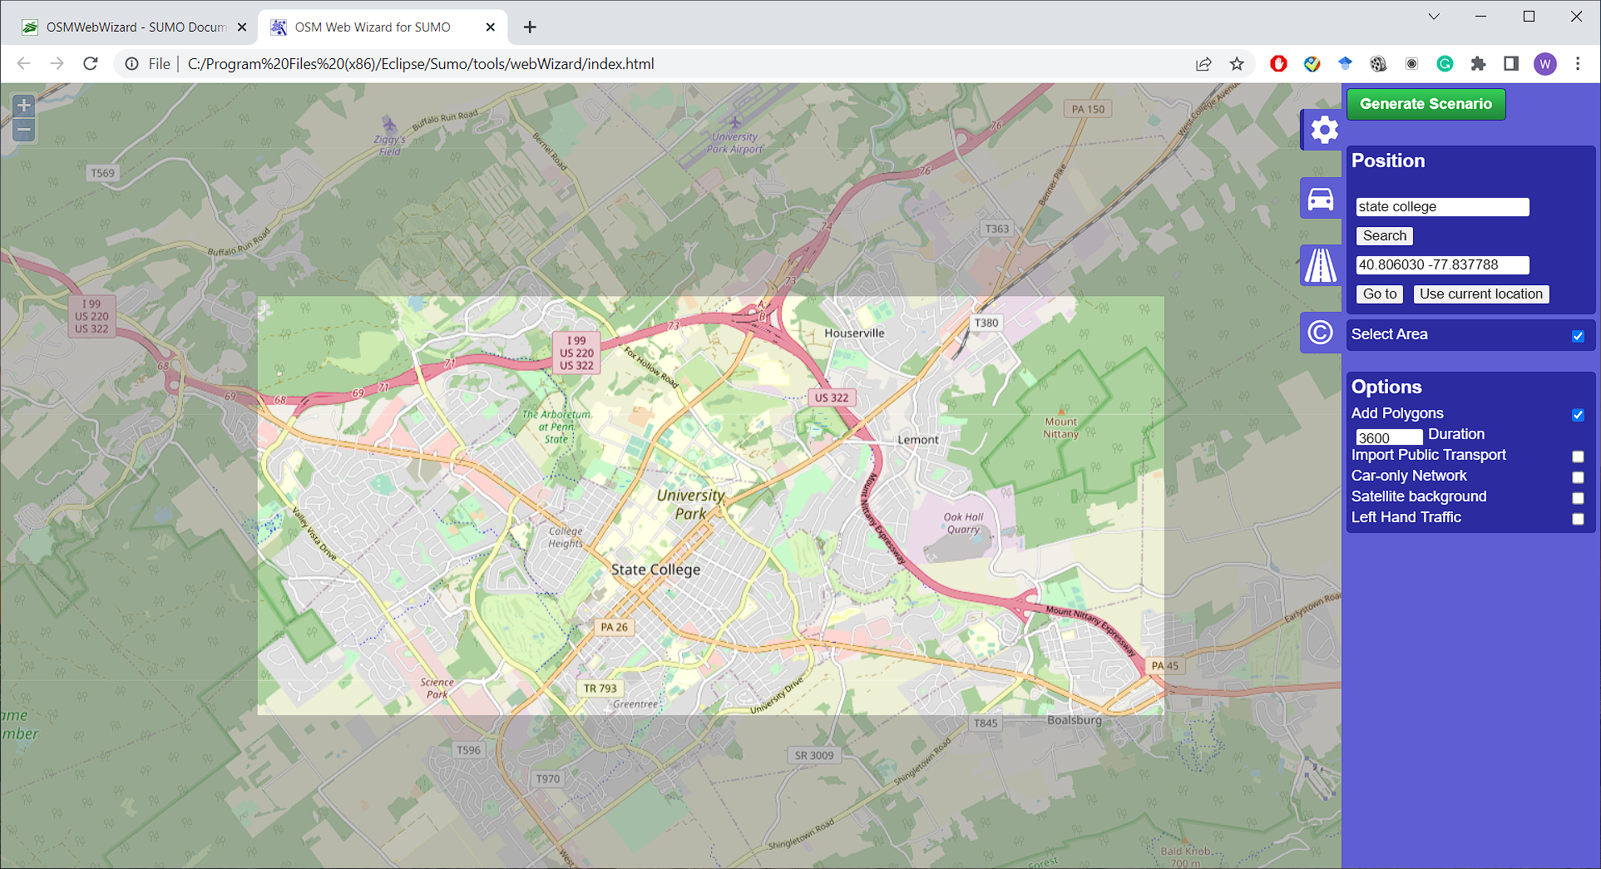
Step 3. select the area you want to simulate by clicking “select area”. Note that the bigger area you select, the longer it takes to generate the simulation files.

Slide 7
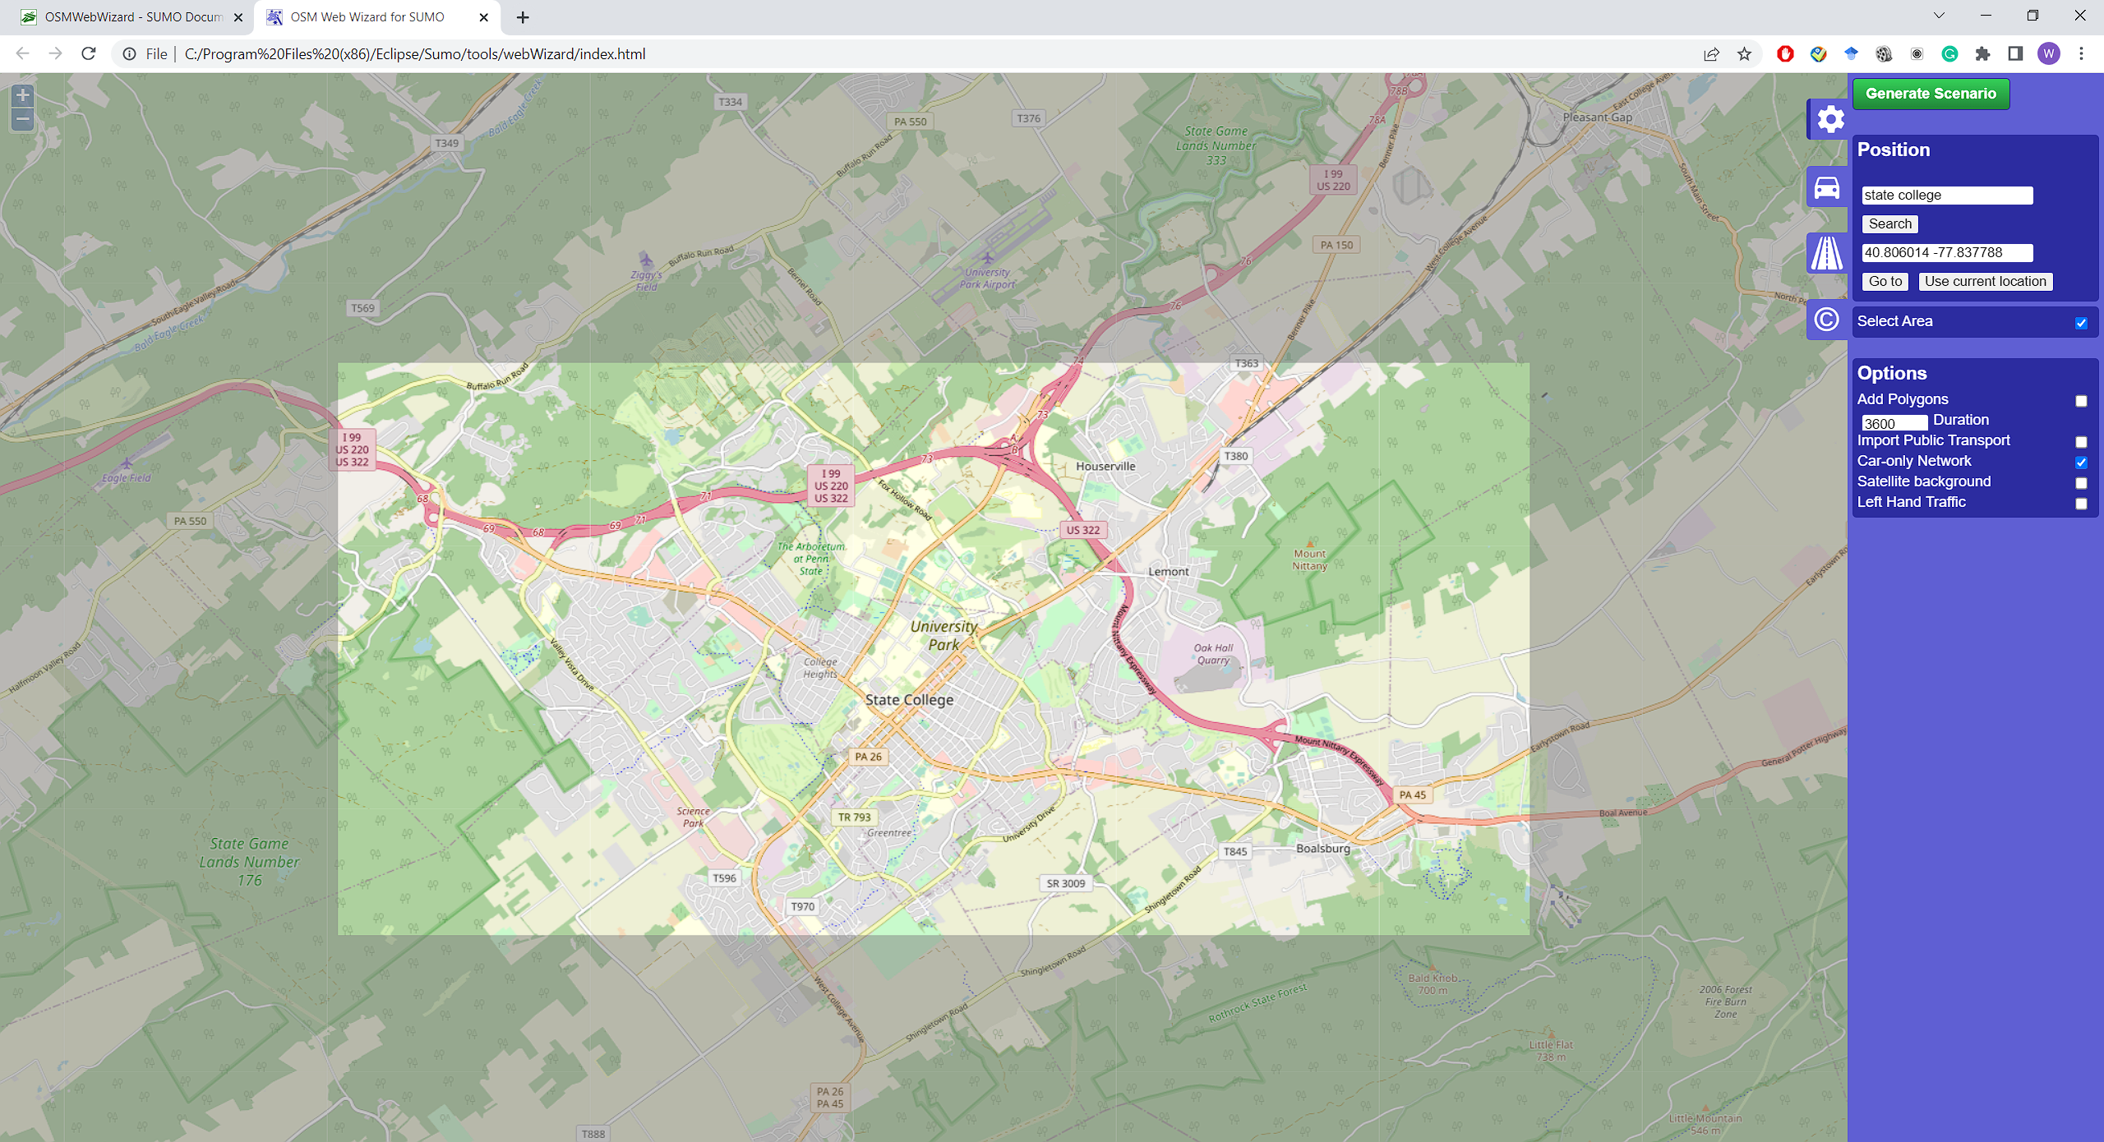
Step 4. Select options. For the purpose of simplicity, we disable Add polygons(which imports buildings) and enable Car-only Network(which import only roads for passenger vehicles).

Slide 8
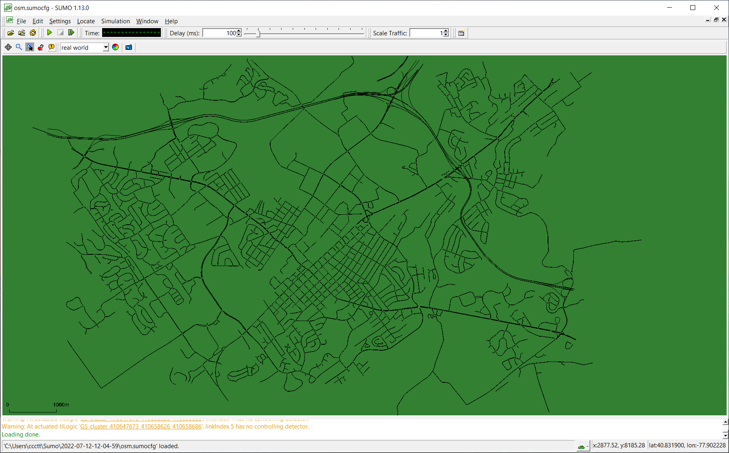
Step 5. Click on “Generate Scenario” to generate files to run the simulation. SUMO-GUI pops up.

Slide 9
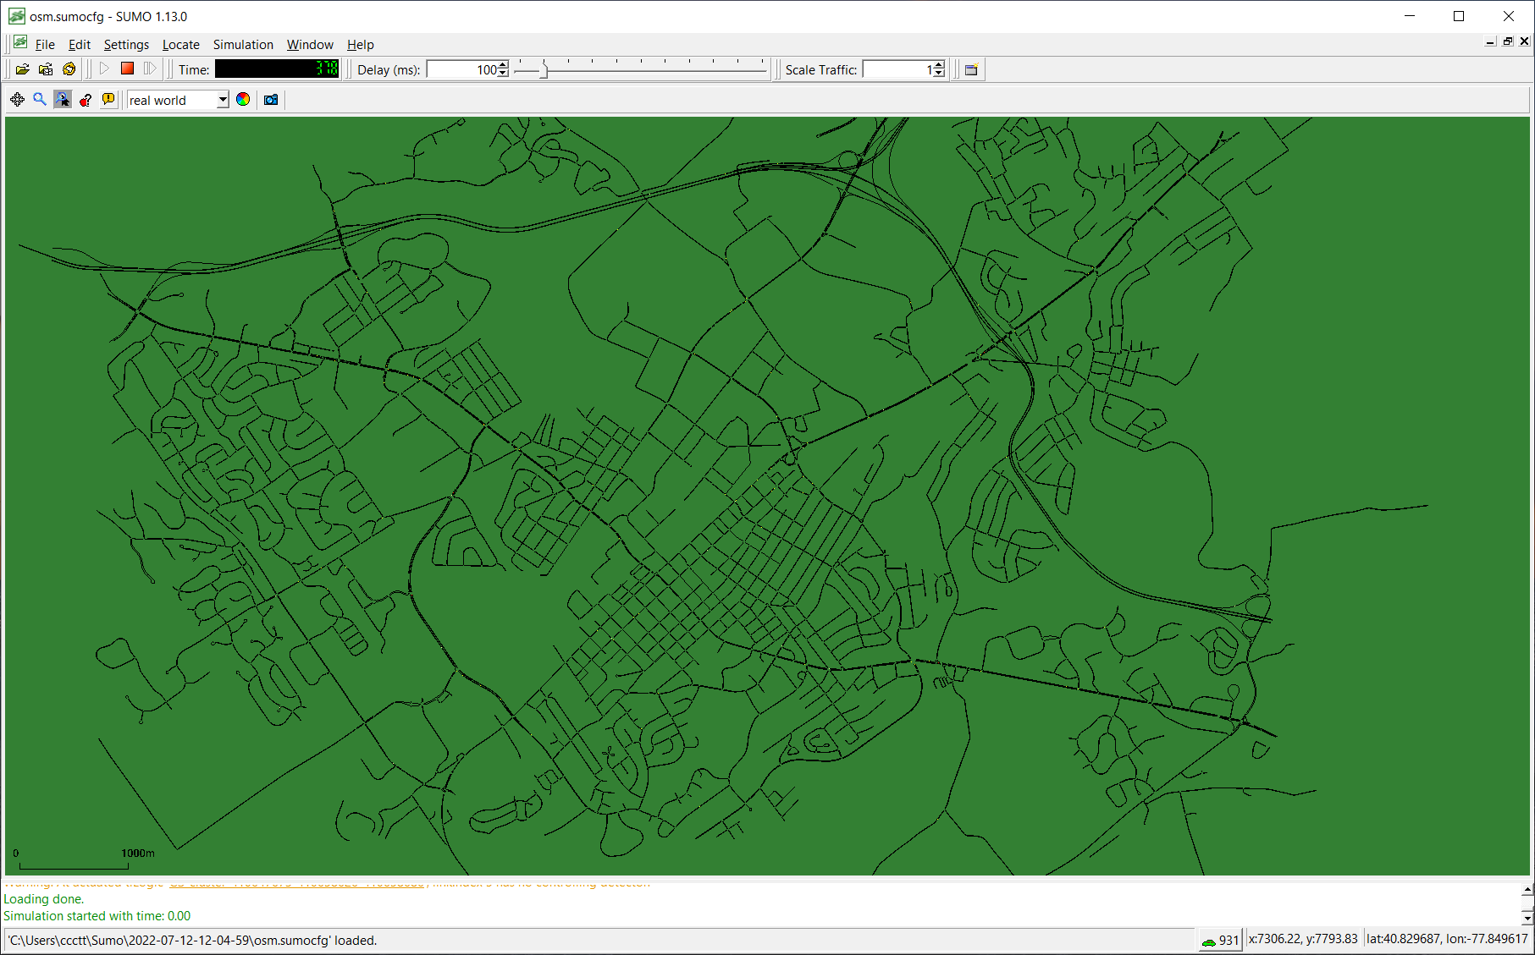
Step 6. Click on play button to run the simulation. Note that in this view, vehicles look very small.
Play

Slide 10
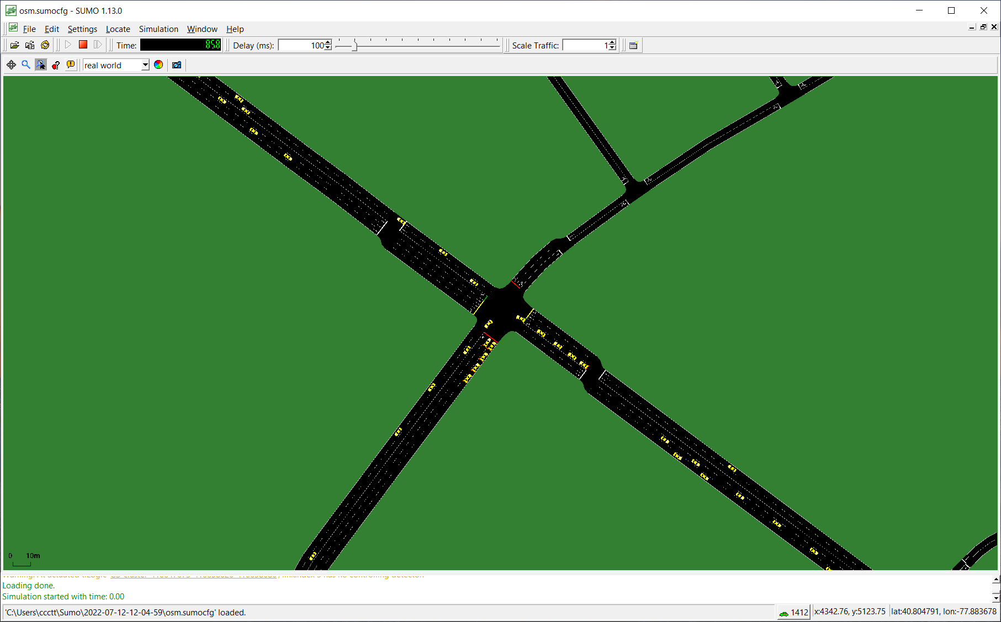
Step 7. If you zoom in, you can see the vehicles running on streets.

Slide 11
Files have been generated to reproduce the simulation.
The files can be found at: https://github.com/ivsg-psu/TrafficSimulators_GettingStartedWithDifferrentSimulators_GettingStartedWithSUMO/tree/main/Data
This document can be found at: https://github.com/ivsg-psu/TrafficSimulators_GettingStartedWithDifferrentSimulators_GettingStartedWithSUMO/tree/main/Documents

